Slide 1
ANALYZING SWIGGY: BANGALORE DELIVERY OUTLET DATA
Detailed Project Report
Author: Mohammad Wasiq
Version: 1.0
E-mail: gl0427@myamu.ac.in
Last Date of Revision: 18/03/2023

Slide 2
OBJECTIVE
The online food ordering market includes foods prepared by restaurants, prepared by independent people, and groceries being ordered online and then picked up or delivered. The first online food ordering service, World Wide Waiter (now know as Waiter.com), was founded in 1995. Online food ordering is the process of ordering food from a website or other application. The product can be either ready-to-eat food or food that has not been specially prepared for direction consumption.

Slide 3
BENEFITS
User can easily analyze about their best restaurant through the dashboards in terms of how many price and ratings.

Slide 4
DATA DESCRIPTION
As we have seen earlier, in our Swiggy dataset, we have around 118 records with 5 different features. Features are distributed as 2 Continuous features and 3 Categorical features. These datasets are given in the form of Comma SeparatedValues) .csv) format.

Slide 5
DATA DESCRIPTION
Features
Shop_Name: Name of the shop and its data type is text.
Cuisine: Food name which are available in shop and its data type is text.
Location: Location where shops are located and its data type is text.
Rating: It’s a rating of shop and its datatype is numeric.
Cost_of_two: It is a cost of two Cuisine and its data type is numeric

Slide 6


TOOLS USED

Slide 7
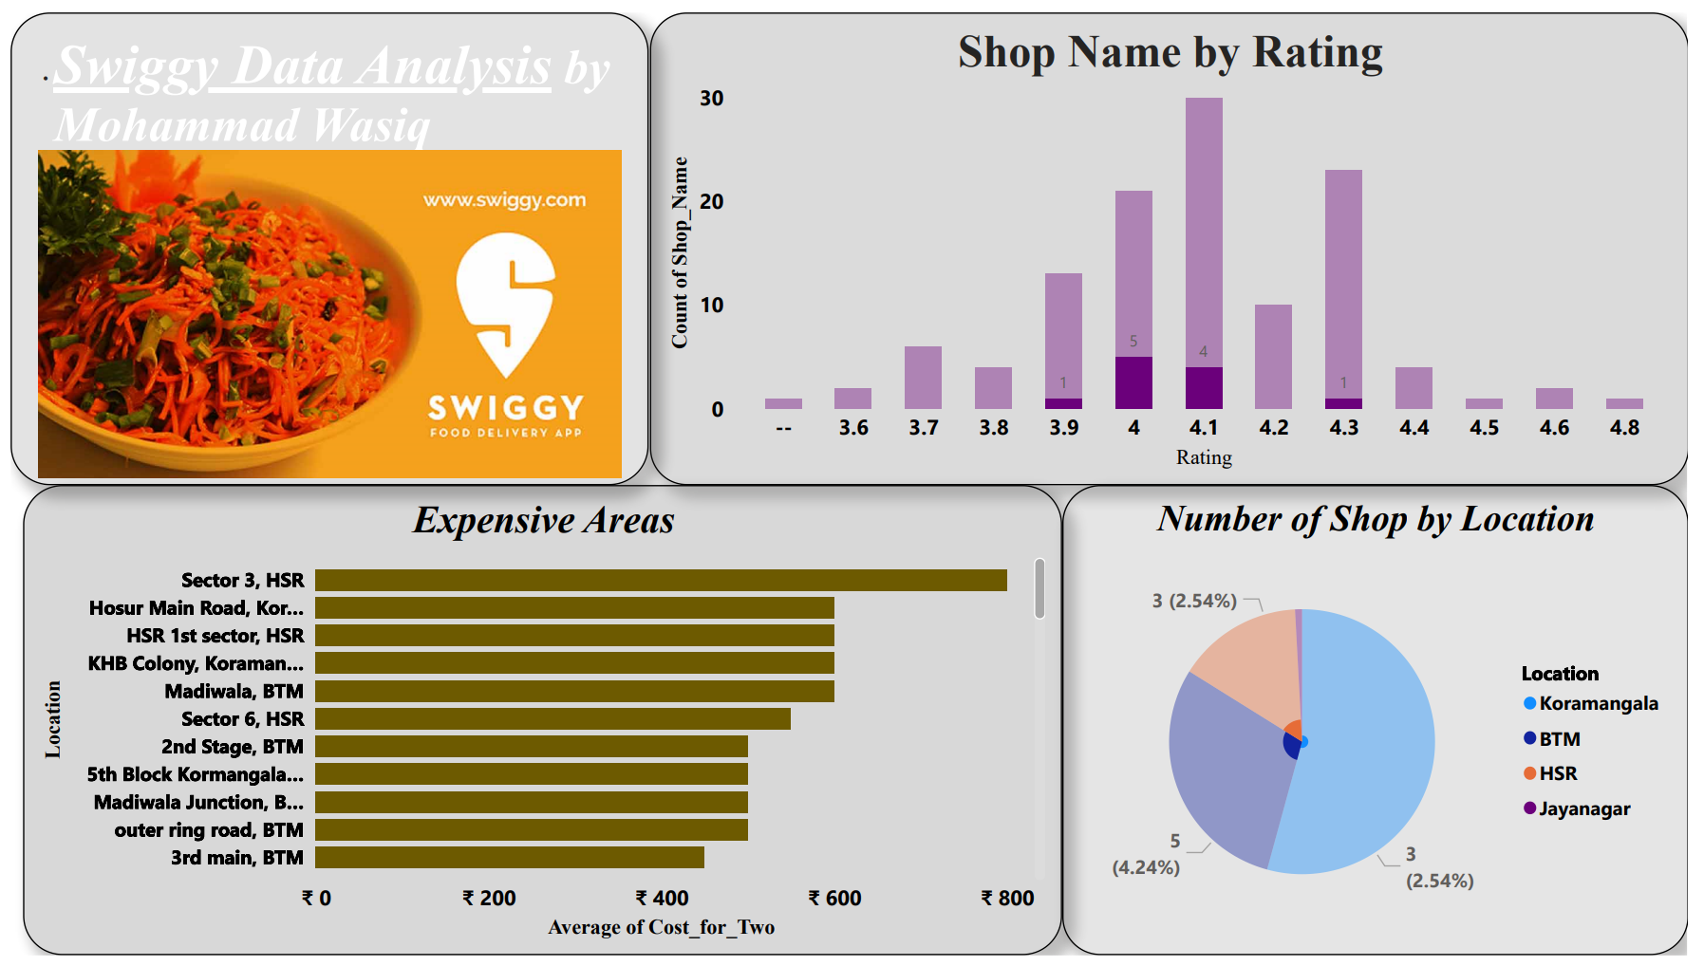
DASHBOARD 1

Slide 8
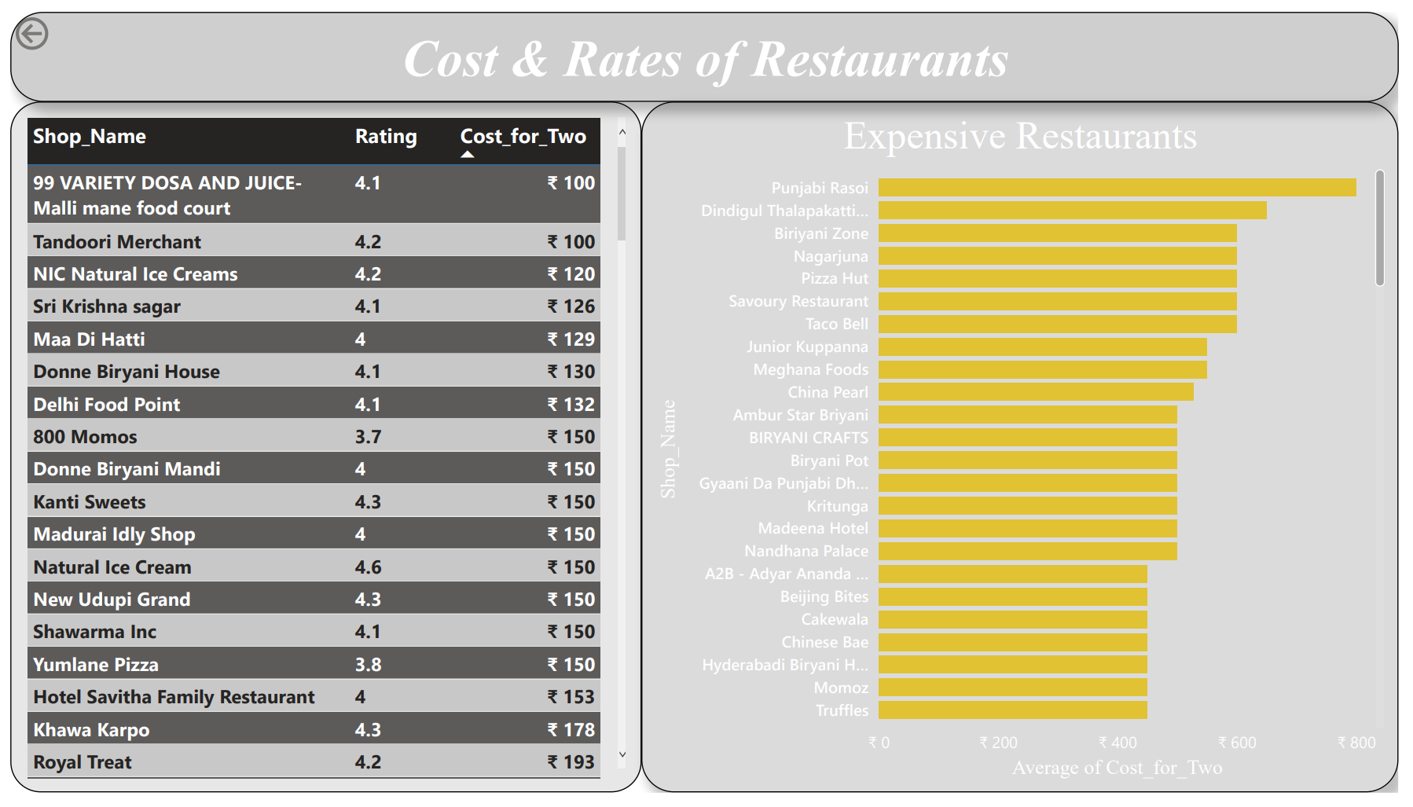
DASHBOARD 2

Slide 9
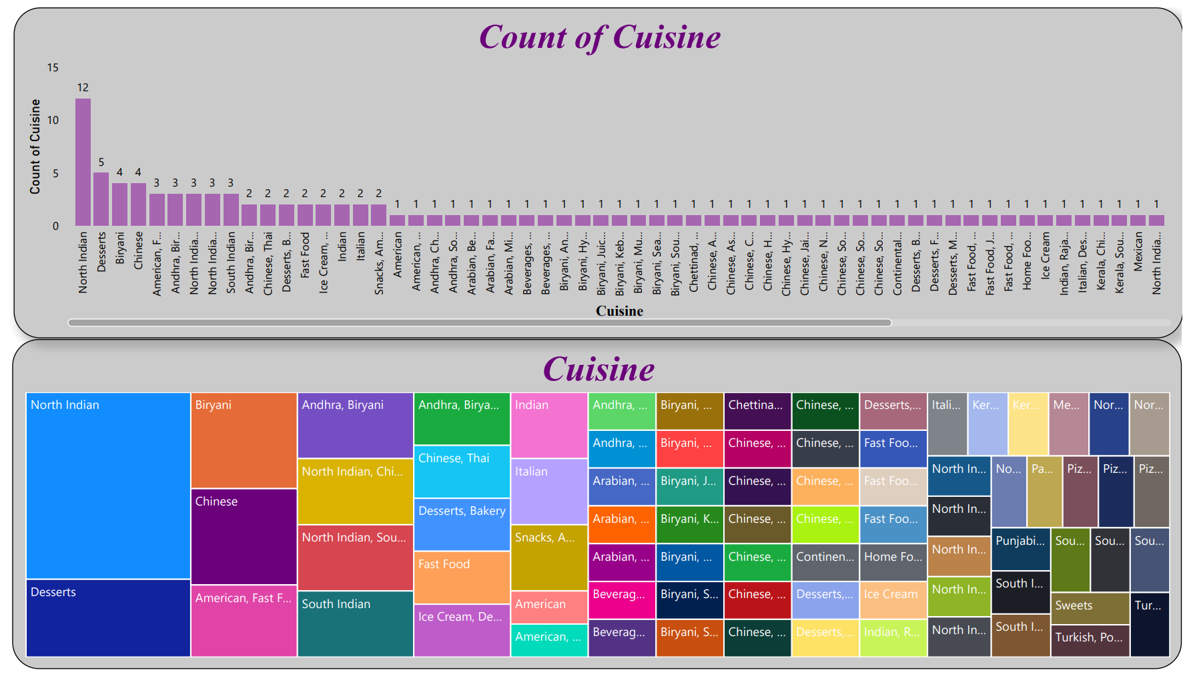
DASHBOARD 3

Slide 10
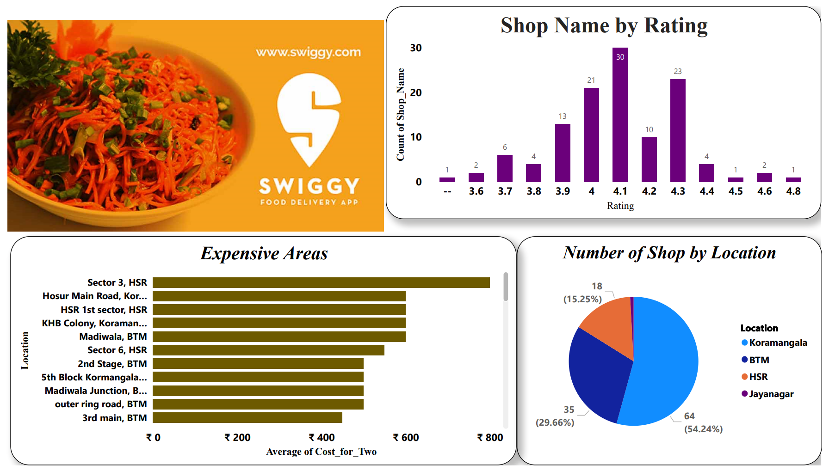
DASHBOARD 4

Slide 11
ANALYSIS
We find the number of outlet for particular cuisine.
Average Cost for two cuisine.
Affordable and Highest Rated Restaurant.
Expensive Restaurant.
North India Cuisine have highest outlets.
99 Variety Dose and Juice is the cheapest and affordable restaurant.
Koramangala have the highest number of restaurant

